Slide 1



Mahavir Education Trust’s SHAH & ANCHOR KUTCHHI ENGINEERING COLLEGE CHATBOT FOR INTERACTIVE WEBSITE
BY-
Saurav Jha BE-7
Prashant Pandey BE-7
Dhanraj Mhatre BE-7
Priyanka Bhadane BE-7
Under the guidance of -
Mr. Rohan Borgalli

Slide 2
Outline
Introduction
History
Motivation
Literature Survey
Proposed Work
Problem Statement
Block Diagram
Implementation
Results
Advantages and Disadvantages
Applications
Conclusion
References

Slide 3
Introduction
Nowadays, as we see, the number of students in college has constantly risen so does their needs
Chatbots have the potential to solve this problem using the examples of other sectors.
Chatbots in education promise to have a significant positive impact on learning success and student satisfaction.
A small number of studies have already shown successfully implemented chatbots in learning scenarios.

Slide 4
History
Eliza is considered as the first Chatbot, which works on the pattern matching system. It is developed by Joseph Weizenbaum in 1964.
ALICE is rule-based chatbot based on the Artificial Intelligence Markup Language (AIML).
JABBERWACKY is a chatterbot created by Rollo Carpenter to simulate human chat in interesting manner.
Md. Shahriare Satu and Shamim-AI-Mamun showed the review of applications of the Chatbot which are developed using the AIML scripts.

Slide 5
MOTIVATION
As students, we require many types of information regarding our college and university during our course.
Getting this information is rather cumbersome and lengthy. This is all long, hectic and unnecessary. This is where we thought of using an intelligent chatbot delivering these informations .
Think about an application, where all you have to do is ask. That’s where our chatbot comes into existence.
Then our chatbot can do it for you in seconds all you will have to do is to ask it. Isn’t it easy and convenient?

Slide 6
Literature Survey
The goal of the following systematic literature review is to set the ground for future research regarding chatbots in various fields.
The literature survey of different IEEE papers are as follows:-

Slide 7
Paper 1:- Extracting Chatbot Knowledge from Online Discussion Forums.
Paper 2:- Chatbot Using A Knowledge in Databa Human to Machine conversation
Key points (Summary)
Keywords:- Chatbot, knowledge extraction, cascaded framework, forum domain, threads.
Method:- The method of selecting valid thread titles and extracting completed sentences from the extracted RRs is an area for exploration.
Type of Chatbot:- Static and Dynamic.
How’s it done:- It’s done using cascaded frame network, messages are extracted using SVM classifier.
Future work:- Planning to improve extracted RR. (Replies)
Key points (Summary)
Key words:- Bigram, Chatbot, database, sentence, similarity.
Method:- Bigram method to design and build tables as representation of knowledge in databases
Language used:- SQL
Type of chatbot:- Dynamic and static.
Future work:- Bigram method can also be used for many other languages with some boundary.

Slide 8
Paper 3:- Chatbot Using Gated End-to-End Memory Networks
Paper 4:- Smart Answering Chatbot based on OCR and Over generating Transformations and Ranking.
Published in: 2016 Eighth International Conference on Ubiquitous and Future Networks (ICUFN)
Important Outcome from The Survey
Keywords— Optical character recognition (OCR), Chatbot, Question Generation via Over generating Transformations and Ranking.
Method of generating Questions from Documents: Over generating Transformation and Ranking Algorithm.
Type of chatbot: Static and Dynamic.
Programming used in this paper: java.
Method we are going to use: python.
Key points(Summary)
Key words:- intelligent, natural language, rule based, gated end-to-end memory networks, supervision, hospital, dialogue system.
Method:- The method of incorporating an iterative memory access control to an end to end trainable memory enhanced neural network architecture.
Language used:- Artificial Intelligence Mark up Language (AIML).
Type of chatbot:- Dynamic
Future work:- There will be investigation in language modelling and predictive learning.

Slide 9
Paper 5:-Chatbot : An Education Support System For Students
Key points(Summary)
Keywords— Chatbot, E-learning, Educational support systems
Method:- The use of natural language processing techniques and the ontologies of domain. ML is used to train the Chabot with the given dataset and natural language processing is used to understand human commands (text and voice) and learn from experience
Type of chatbot: Static and Dynamic.
Programming :- OCTAVE
Programming language we are going to use: PYTHON.
Paper 6:- Briefing paper: chatbots in education
Key points(Summary)
Key words:- Chatbots, education, artificial Intelligence, automation.
Method:- The method to have the ability to provide responses to students queries, which aids access to information and learning contents.
Language used:- Artificial general intelligence (AGI).
Type of chatbot:- Dynamic and Static, both.
Future work:- With the gaze focused on the 20-year horizon, we have to start thinking as a society about the role that AI will play in education and the implications of an AGI.

Slide 10
Paper 7:- Chatbots for learning: A review of educational chatbots for the Facebook Messenger.
Paper 8:-Proposal of an Architecture for the Integration of a Chatbot with Artificial Intelligence in a Smart Campus for the Improvement of Learning
Key points (Summary)
Key words:-Chatbot, Messenger, Facebook, Mobile learning, Quality evaluation.
Method:-Search strategy , Coding of chatbots:-A coding instrument developed to identify chatbots in the following categories: language, subject matter, and platform, Evaluating the quality of chatbot.
Language used:- Artificial intelligence(AI).
Type of chatbot:- Dynamic.
Future work:- The future research can be divided into two fields. The first field is to focus on the developers support to create and offer tools that allow any teacher to integrate chatbots into their classes without difficulty. The second field is a content analysis of the actual conversations with students.
Key points (Summary)
Key words:- Activity recommendation, artificial intelligence, Chatbot, personalized education, smart campus.
Method:- Variable Identification, Chatbot Integrated Architecture- Smart Campus, Analysis of Data, Model of a Chatbot with the Use of Artificial Intelligence.
Language used:- Artificial Intelligence(AI).
Type of chatbot:- Dynamic
Future work:- The AI can recommend that activity aligns with the needs and ways of learning of each of the students.

Slide 11
Paper 9:- The Role of Chatbots in Formal Education.
Paper 10:- Personalization of Student Support Services using Chatbot.
Key points (Summary)
Key words:- Chatbot, Machine learning, Messenger, Applications, Technology.
Method:- Through the use of machine learning, these are programmed to learn from their previous conversations. This learning process often takes place under active development supervision.
Language used:- Natural language processing or understanding (NLP).
Type of chatbot:- Dynamic.
Future work:- They are more likely to be able to disclose supplementary information than to solve content issues.
Key points(Summary)
Key words:- Student Support Services, Chatbot, ERP, CRM, NLP, AI.
Method:- Conversational webservice developed using AI and machine learning algorithms. The services include pre-, post educational assistance, campus life and personal guidance.
Language used:- NLP & AI.
Type of chatbot:- Dynamic.
Future work:- The chatbot will help students in all campus services, assistance in filling various forms, learning and advice services.

Slide 12
Proposed Work
This Information Enquiry chatbot project will be built machine learning algorithms that will analyze user’s understand user’s message.
using python queries and
Machine learning and Natural language processing will be used to answer the users queries.
In some cases, user may find out that the answer given to his/her query is not relevant
The aim of our Proposed System is to develop an bot, which provides answer to the query of the student very effectively. Students just have to put their query to the chatbot.

Slide 13
Problem Statement
Bots are lot easier to ask rather than installing mobile apps.
Bots are easily distributed.
They are useful in pretty much ways like admission related information, exams related doubts, latest notices etc. all they have to do is just ask.
Students can get all the latest information without even paying a visit online.

Slide 14
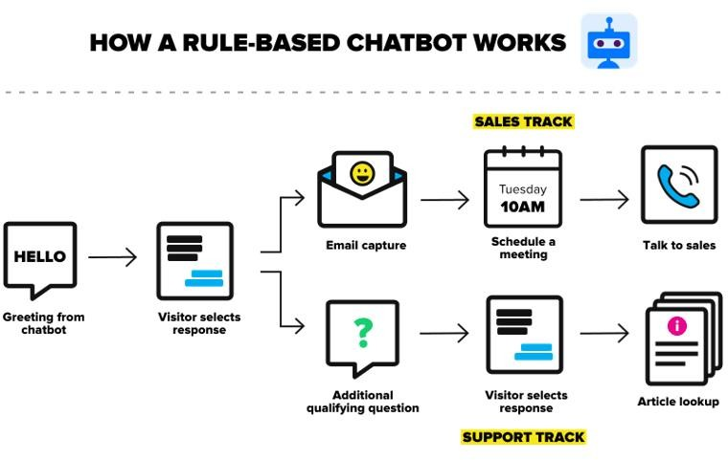
Block Diagram

Slide 15
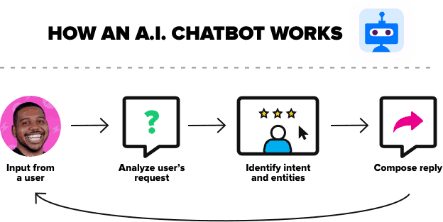

Slide 16


IMPLEMENTATION
Here, the tech stack we’ll need is a frontend app to display the bot.
We used the React library. So, the interface will be made with React. React is a popular JavaScript library.
So, React on the frontend. But React needs the information what to show. That’s why we need the backend app.
And backend app is be hosted on Heroku.
Backend will be built with Node.js, so again JavaScript,
Node is a great language for backend web apps.
Express is a framework that makes building backend apps much easier task.
We’ve further used Dialogue flow and NLU which is explained in next slides.

Slide 17
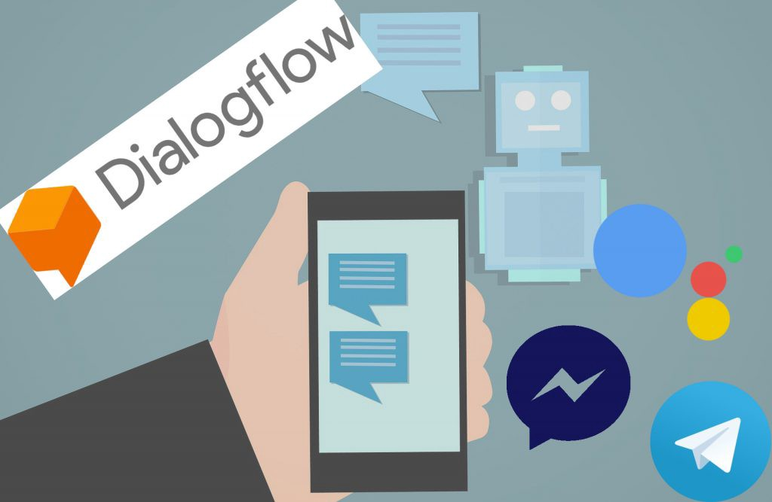
Dialogue Flow And NLU
DialogFlow is a Google service, an NLP, that is natural language processor. What does that mean?
You probably heard of NLP and NLU. That sounds similar but is not the same.
DialogFlow is NLU but it is much more than that, it’s also NLP.
NLU in natural language understanding.
NLU transforms natural language to something a computer or our app can understand.
In other words, NLP let's people and machines talk to each other “naturally.”
So, DialogFlow also helps with returning the right response and it provides integrations to chat platforms.

Slide 18
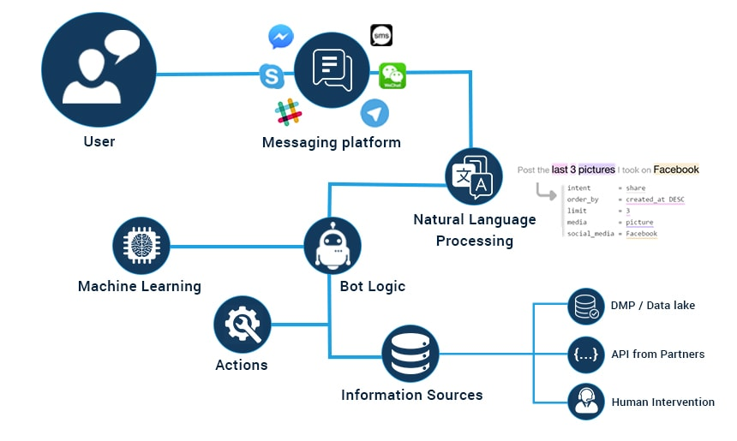
How is NLP used to create chatbot?

Slide 19
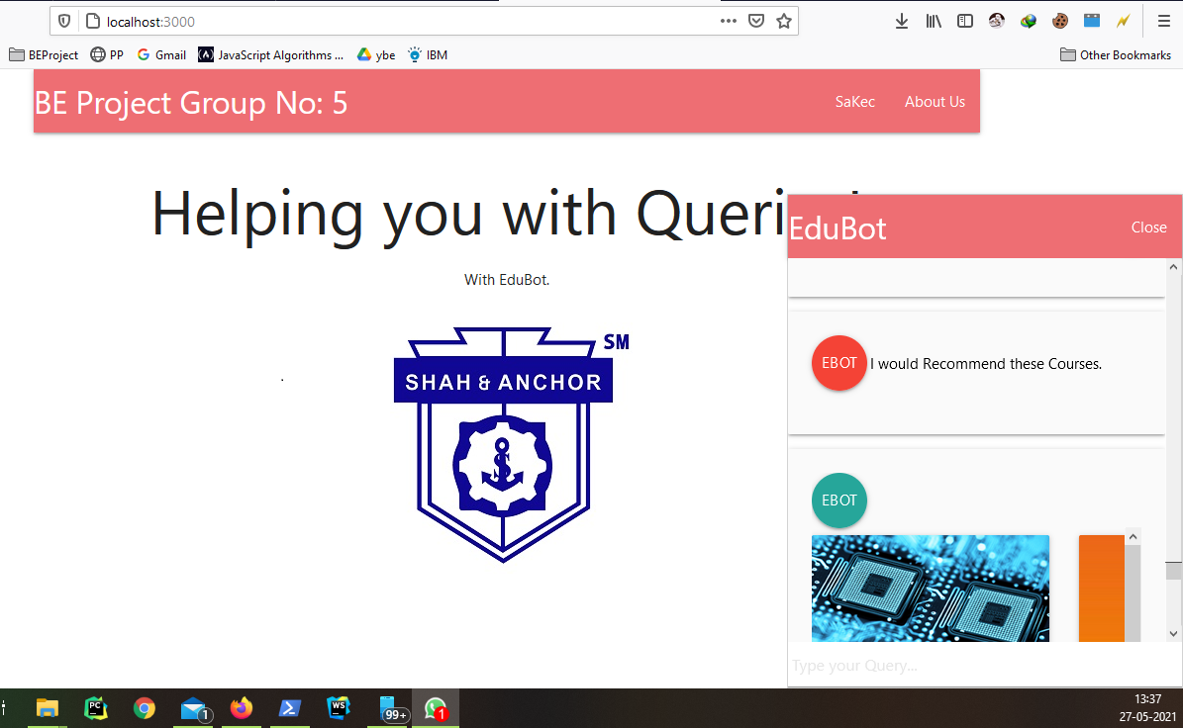
RESULTS

Slide 20
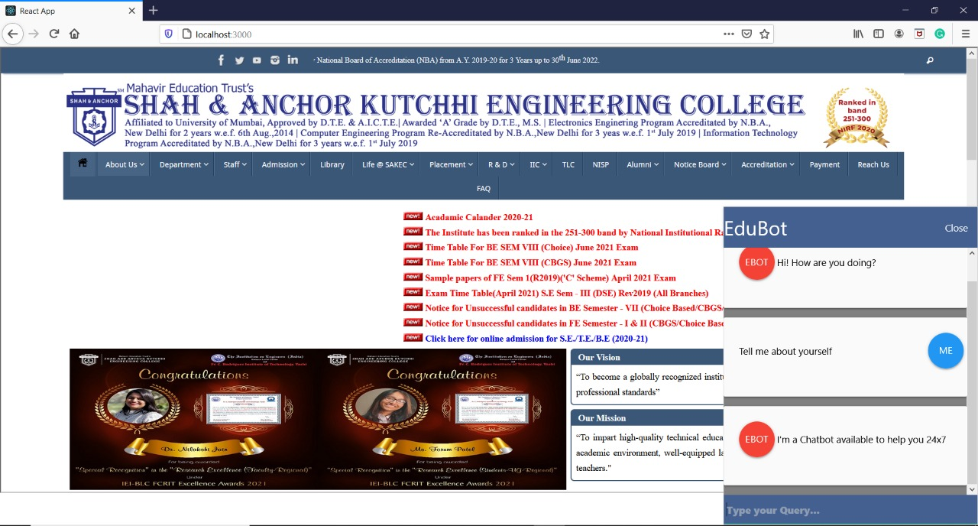
Final Output -

Slide 21
1. Advantages
To Convert More Website Traffic
To Generate More Qualified Leads
To Automate Business Processes
To Elevate Customer Service
2. Disadvantages
While not all consumers are ready to trust chatbots entirely, most still acknowledge that chatbots are poised to provide several benefits that can enhance their online experiences.
Chatbots are the new apps, but they’ve yet to completely replace the need for phone and email when it comes to communicating with businesses.
Chatbots can’t replace phone or email when it comes to providing in-depth answers to technical questions (some things will always require a human touch), they are poised to become the new apps.

Slide 22
Applications
Chatbots can be utilised for the following:-
For Better Customer Experience. A chatbot can provide customer service, present product recommendations and engage customers through marketing campaigns.
Conversational Commerce.
Personal Assistance.
For Project Management.
For Data Gathering and Analysis and many more.

Slide 23
Conclusion
The Main objective of the project is to develop and algorithm that will be
used to identify answers related to users submitted questions.
A database will be developed, which will store information about queries, keywords, logs, and feedback messages.
Results have found that the application developed is able to correctly fulfil its purpose within a short time period.
Our result show that the total time required to perform all the task, including visit to the college, standing in queue, and enquiry are reduced with the help of our system.

Slide 24
References
[1]. J. Bang, H. Noh, Y. Kim and G. G. Lee, "Example-based chat-oriented dialogue system with personalized long-term memory," 2015 International Conference on Big Data and Smart Computing (BIGCOMP), Jeju, 2015.
[2]. E. Haller and T. Rebedea, "Designing a Chat-bot that Simulates an Historical Figure," 2013 19th International Conference on Control Systems and Computer Science, Bucharest, 2013.
[3]. S. J. du Preez, M.Lall and S. Sinha, "An intelligent web based voice chat bot,"
EUROCON 2009, EUROCON '09. IEEE, St. - Petersburg, 2009.
[4]. Bayu Setiaji and Ferry Wahyu Wibowo IEEE paper- iChatbot iUsing iA iKnowledge iin iDatabase iHuman-to-Machine iConversation iModeling. 2016.
[5]. Chatbot iUsing iGated End-to-End iMemory Networks-- Jincy Susan Thomas1, iSeena Thomas2 -3rd March 2018. (IRJET)
[6].Weizenbaum, Joseph (January1966), LIZA—A Computer Program For the Study of Natural Language Communication between Man and Machine Communications of the ACM, 9 (1).
[7]. Mauldin, Michael (1994), "Chatterbots, Tiny Muds, and the Turing Test: Entering the Loebner Prize Competition", Proceedings of the Eleventh National Conference on Artificial

Slide 25
